Slide 1
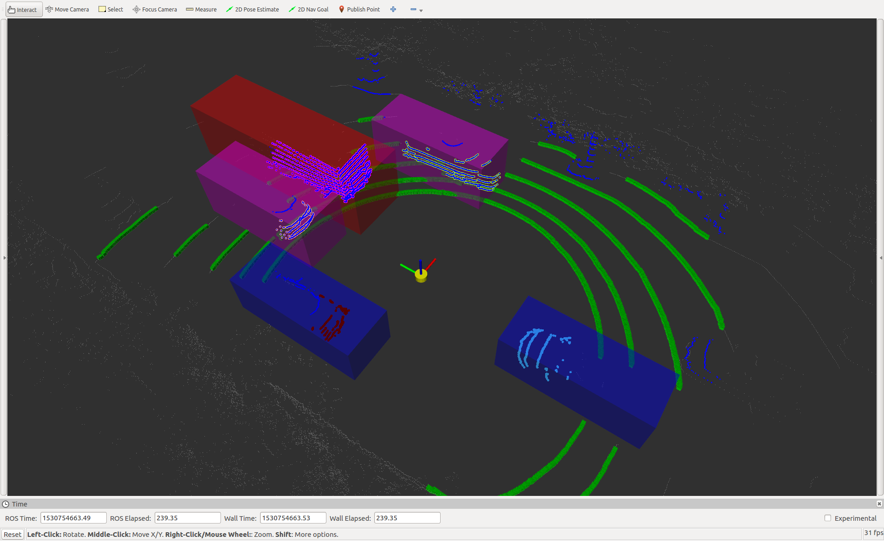
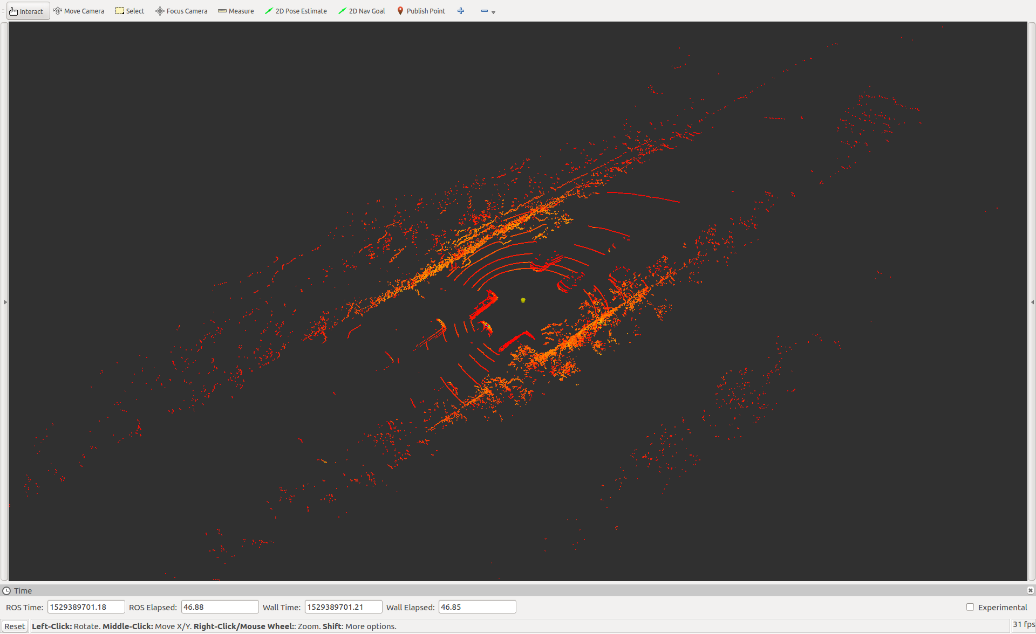
SAIC Motor: Summer Intern Project Lidar Utility
Nikolas Gamarra

Slide 2
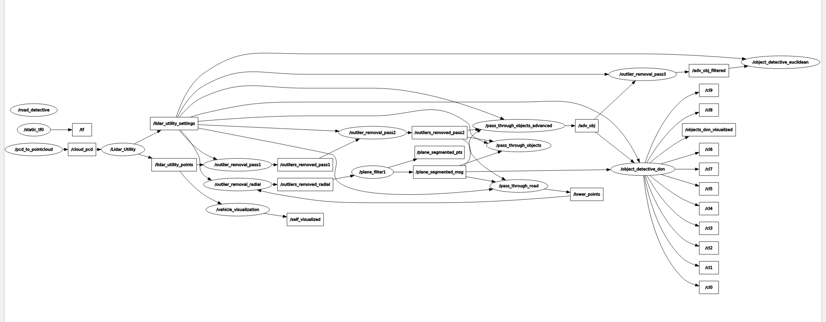
Program Structure
Lidar Utility is programmed for ROS(Robot Operating System) in C++ and utilizes PCL (Point Cloud Library)
A series of ROS nodes filter and interpret the data and send PC2 (Point Cloud 2) & custom messages to each other. This makes the program highly modular and reconfigurable.
- The highest node selects the data source automatically, standardizes X,Y,Z orientation, configures settings
- Middle nodes filter the data to make it easier to interpret
- The lowest nodes interpret the data (object/road detection)
*old but comprehensive map of nodes and topics
Notes:
2

Slide 3
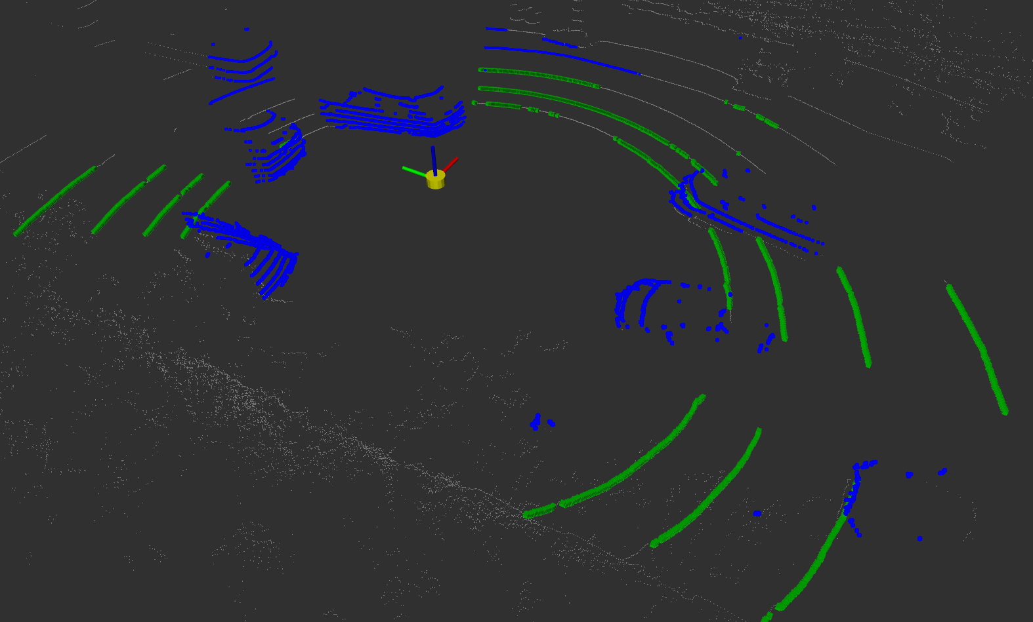
Filtering the data
To make the data easier to process the raw point cloud is first filtered into several smaller clouds.
Statistical outliers are removed
A cloud of points below a certain height is created
Radial outliers are removed from the lower point
A planar segmentation is performed on the lower points and X,Y,Z min/max of the lower points is found (GREEN)
The points above the road as calculated in step 4 are filtered by a box. (BLUE)
Notes:
Filtering the data like this helped with false positives for cars/trees that were not on the road.
3

Slide 4
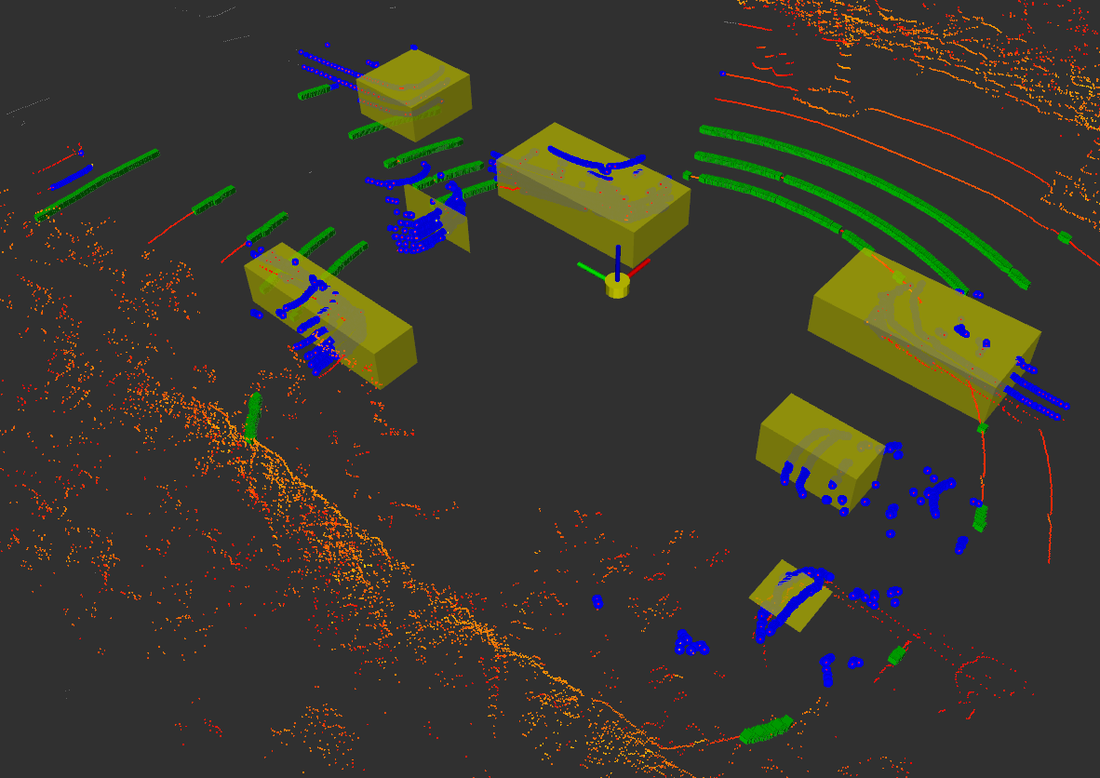
Clustering and Object Detection Euclidean Cluster Extraction
To start I implemented a simple Euclidean Clustering node
For each point it adds neighbors to the working cluster if within a radius and then checks the points it has added for neighbors ignoring already checked points and expanding the cluster.
Pros:
+ Fast
+ Easy to implement
Cons:
Prone to false positives/negatives
Can clump vehicles that are close

Slide 5
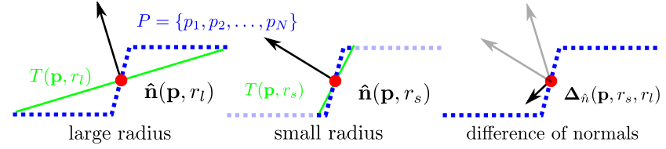
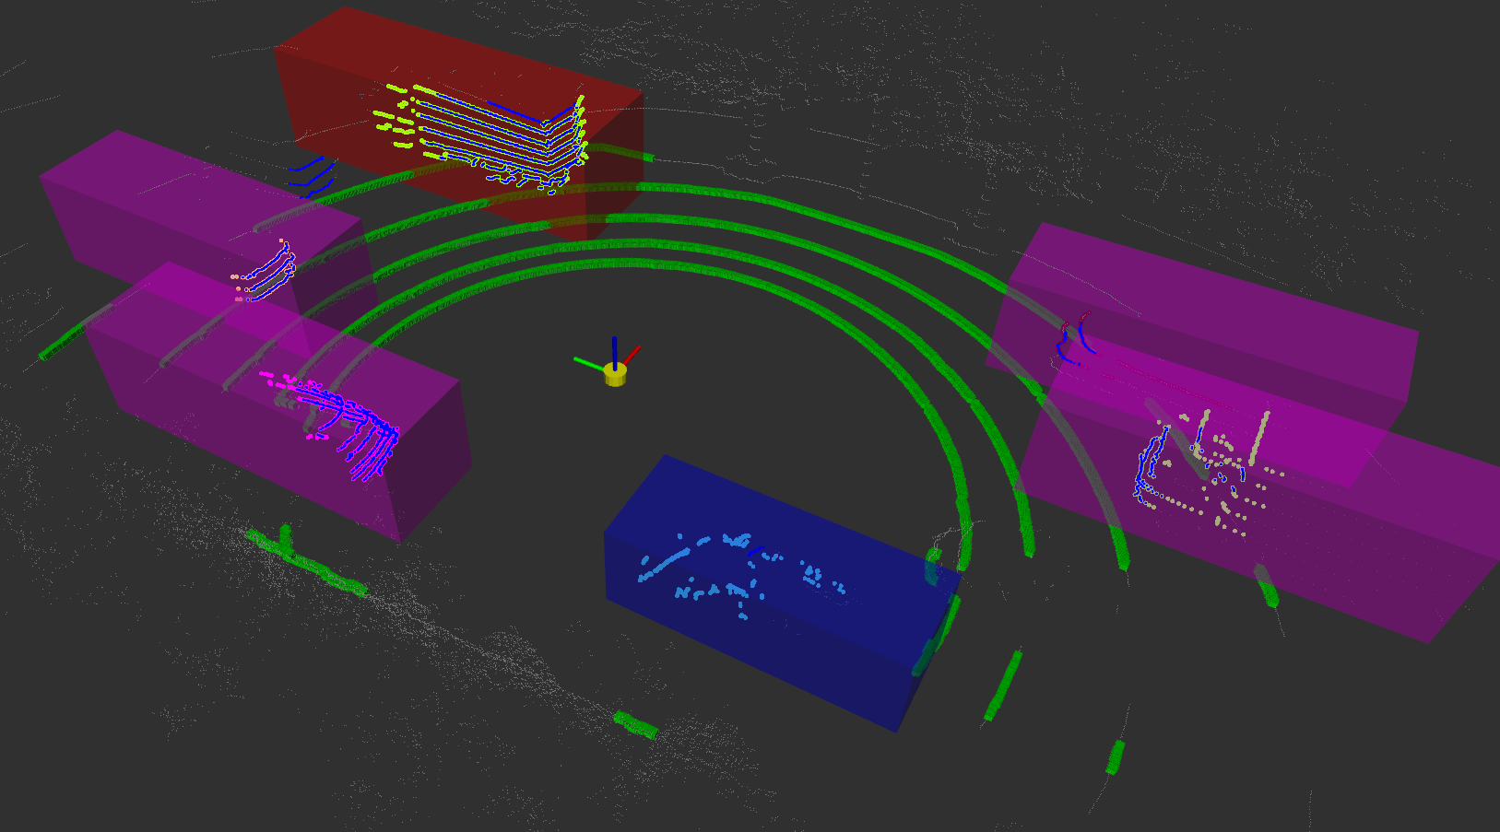
Clustering and Object Detection Difference of Normals (DoN)
To improve accuracy I switched to a Difference of Normals algorithm.
Also uses pervious clustering algorithm but also calculates DoN for each point to make a more informed clustering decisions.
Pros:
+ Much higher accuracy
+ Lower rate of clumping of different vehicle
Cons:
Slower
Harder to tune
(TRUCK) (CAR) (LARGE CAR)

Slide 6
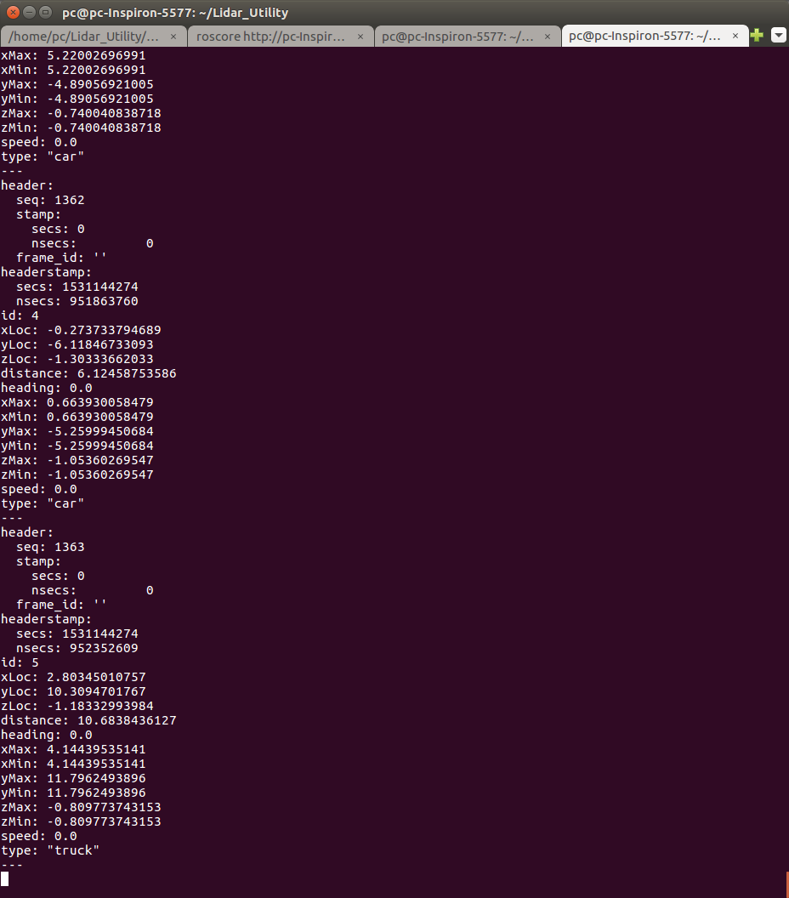
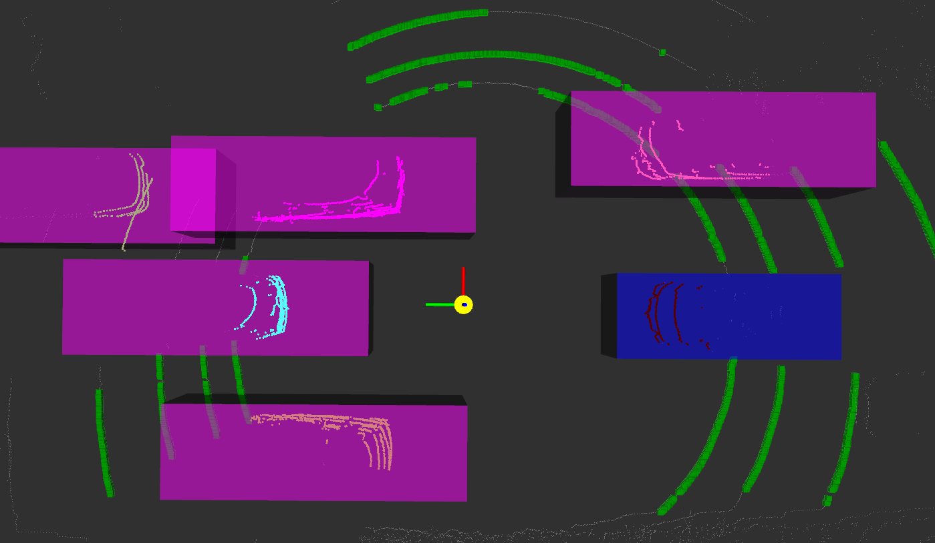
Publishing type and location
In addition to publishing the vehicle visualizations for RVIZ, my object detection publishes a ROS topic with detailed information about the vehicles.
The values for type and location had to be modified based on the location to improve accuracy.
Location, distance, type, and size information are fully implemented.
Heading and speed exist as placeholders.

Slide 7
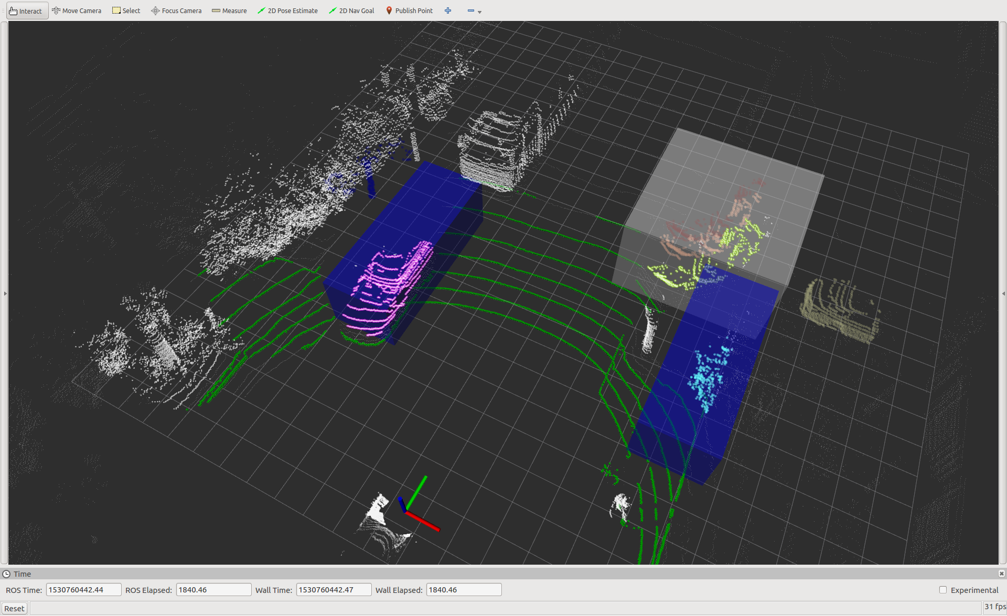
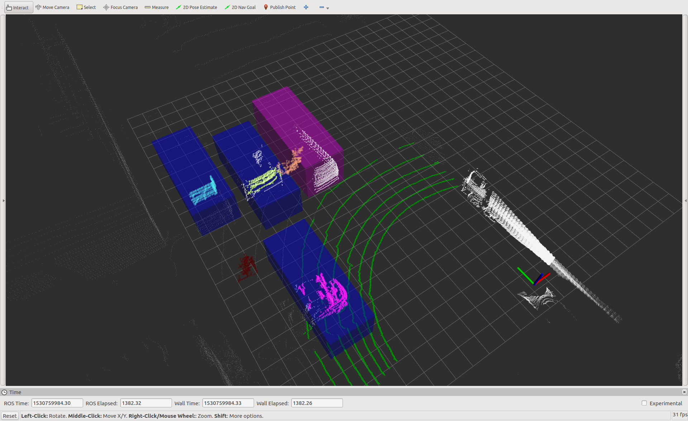
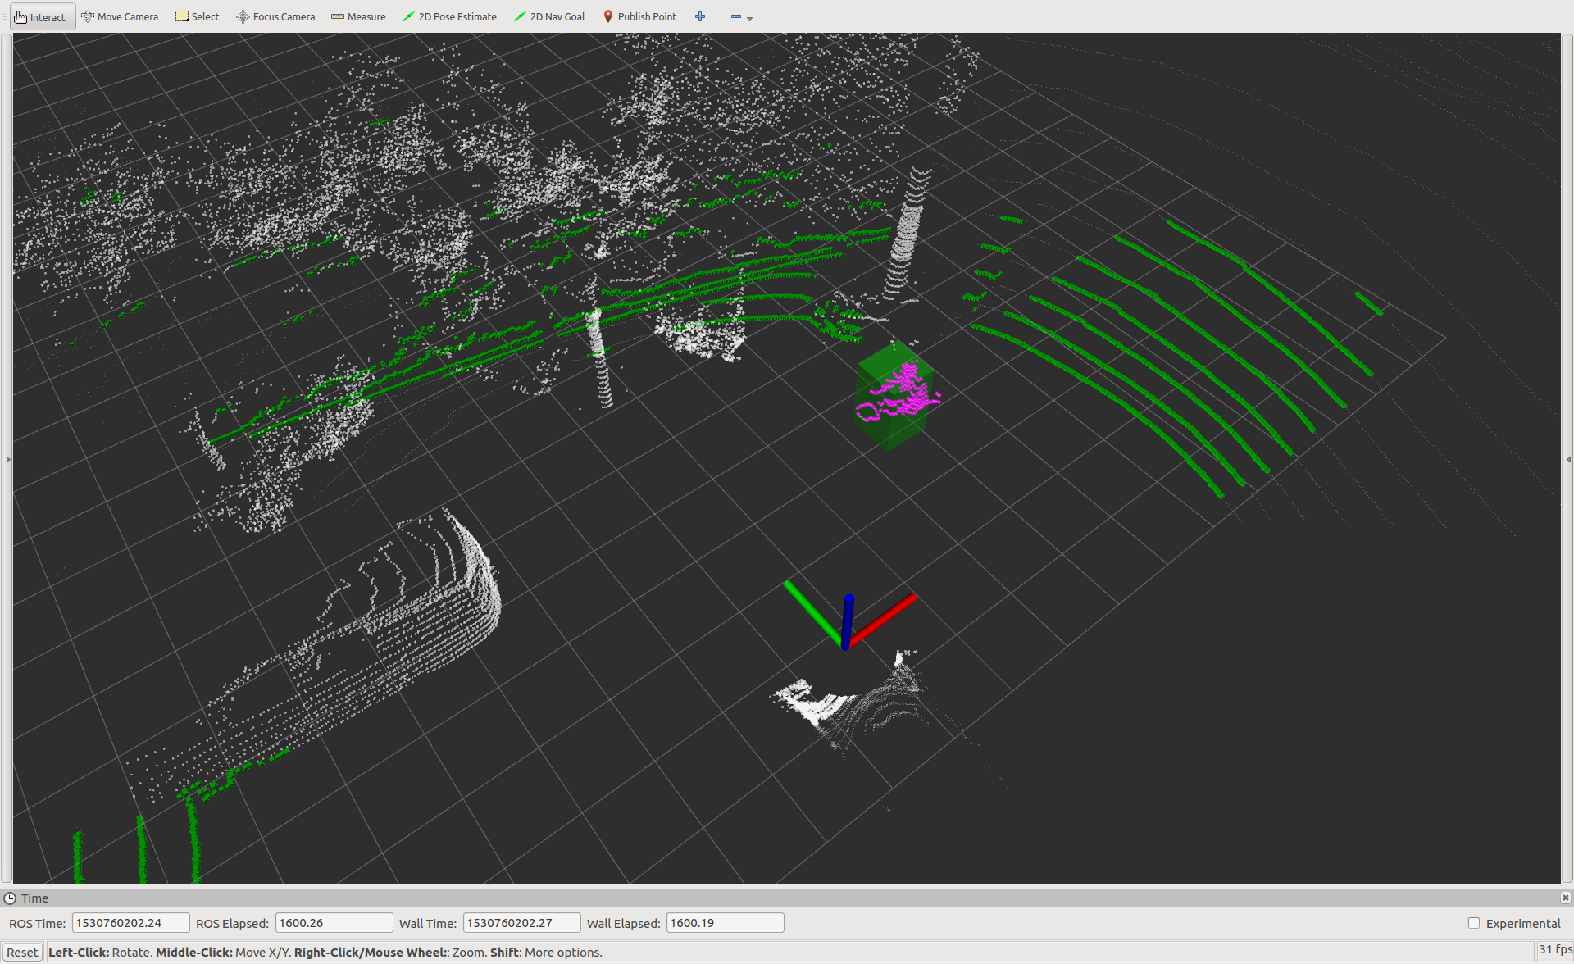
Live data
Created a script for quickly configuring static IP for setting up a device to communicate with the lidar.
Used rosbag to record PC2 topics and play them back later.
Ran into difficulty with the speed efficiency of my program. Had to play data back at reduced speed.
Data is much more complex
than original static dataset.
Ran into frequent false
positives and negatives
for object detection.

Slide 8
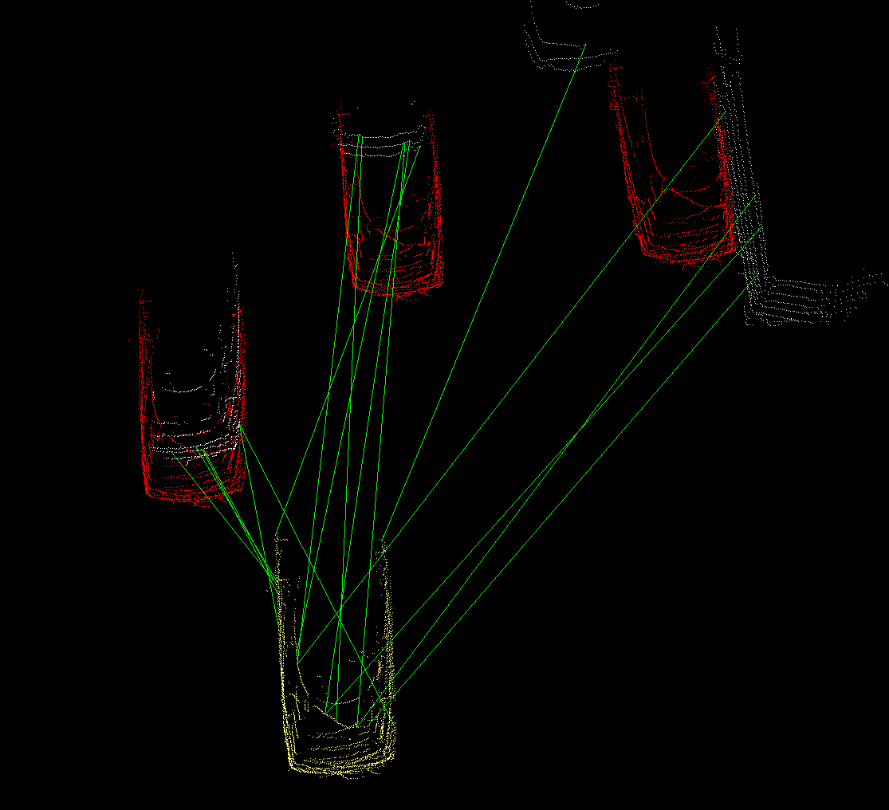
Hypothesis Verification for 3D Object Recognition
As an experiment I played around with implementing a PCL hypothesis verification algorithm outside of ROS.
I made a point cloud of an ‘average’ car by merging cars in a sample.
With a lot of tuning of the algorithm I was able to get a good result only occasionally and under ideal circumstances.
To truly implement this kind of object detection machine learning and lots of training data would need to be used.
Done properly with machine learning this method could provide much higher location and type accuracy.

Slide 9
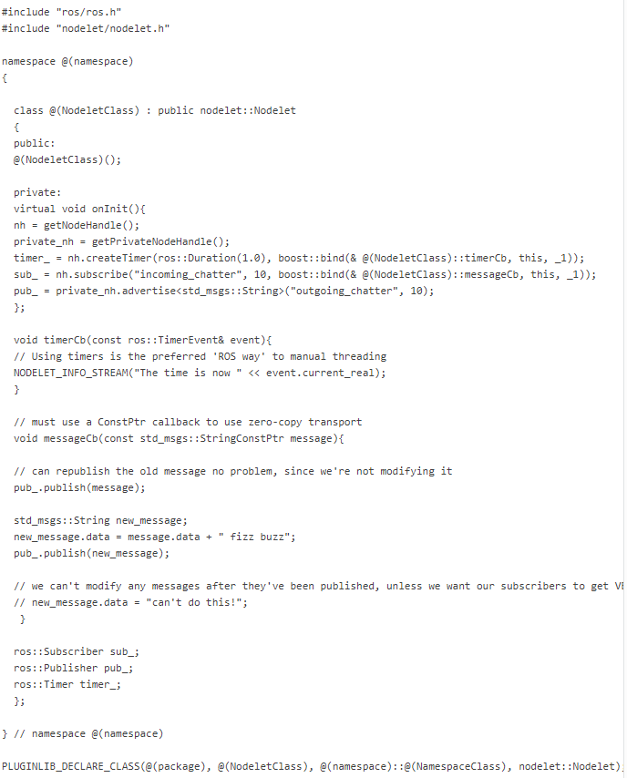
Switching to using ROS Nodelets
To try and compensate for runtime performance issues that occurred when using live data I ported my ROS nodes to nodelets.
Nodelets allow for zero copy transport between algorithms. This can be done because the nodelet topics are actually C pointers. This is achieved by utilizing C plugins, allowing for dynamically loading nodelets.
These nodelets can behave like they are their own node but can communicate with each other as quickly as if their code was in the same node. Creating a best of both worlds scenario with modularity and efficiency.

Slide 10
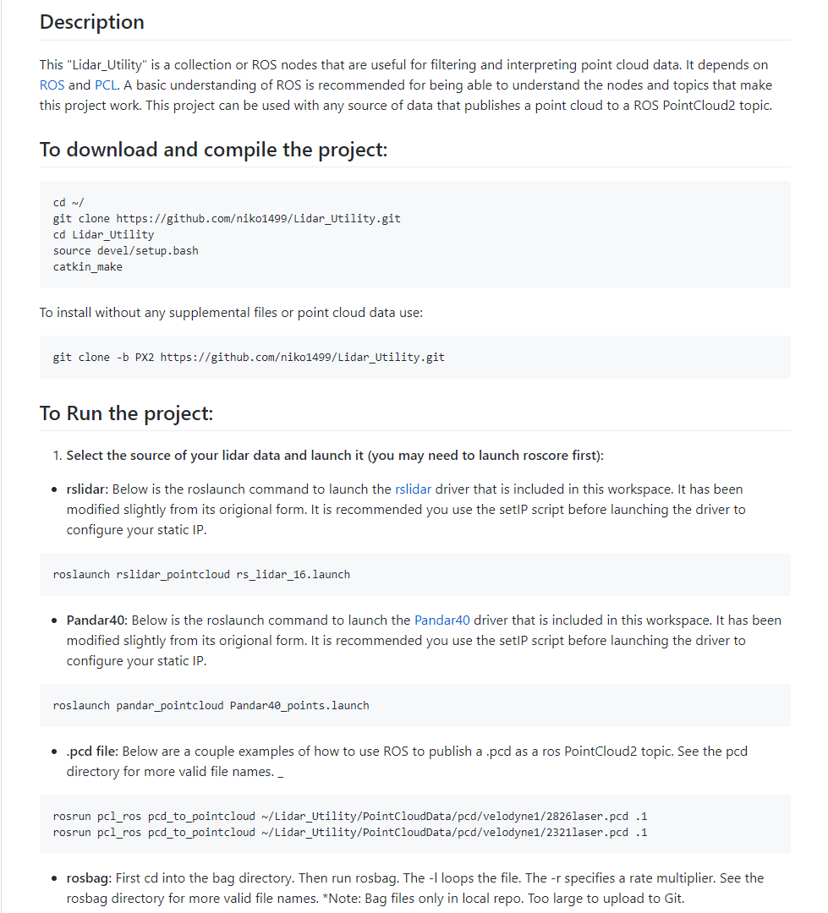
Use of program & Potential next steps
My hope is that this program can be useful for rapidly prototyping some simple sensor fusion projects in the future.
Because of ROS’s modular nature; adding sensor fusion, SLAM, free space detection, ect can be done easily and quickly. These could be potential projects for other interns who wish to learn more about ROS, PCL, or sensor fusion. This can be used as a proving ground for ideas before time intensive implementation outside of ROS.
I have created an extensive readme and commented my code so that my program can be run or changed easily.

Slide 11

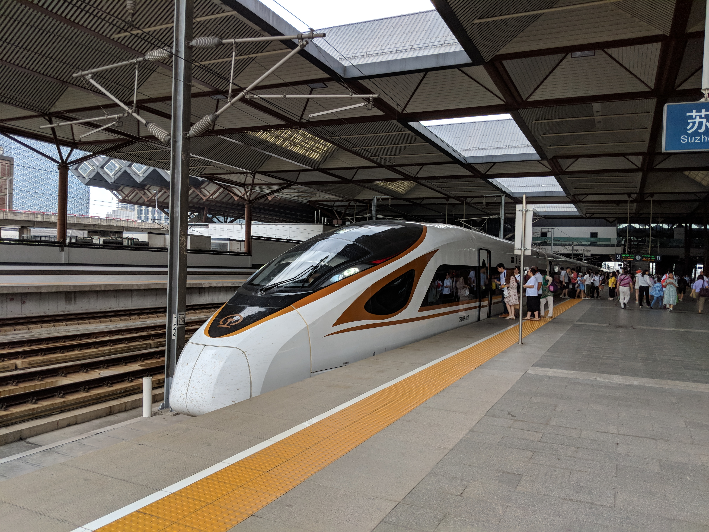
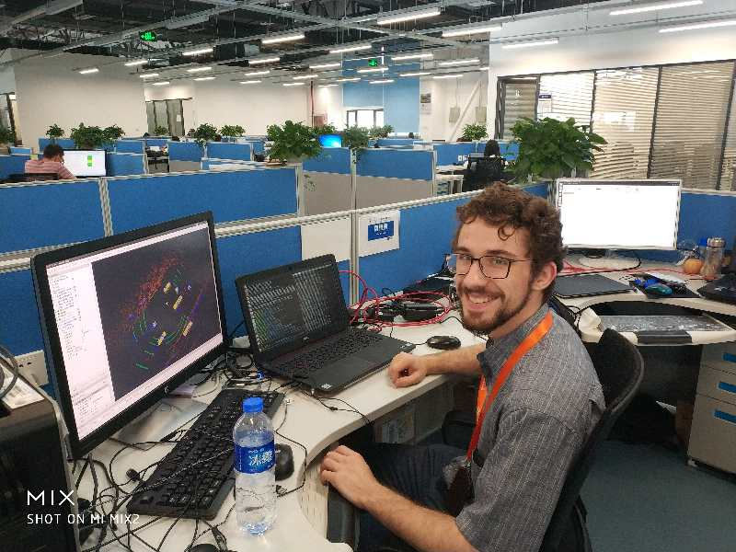

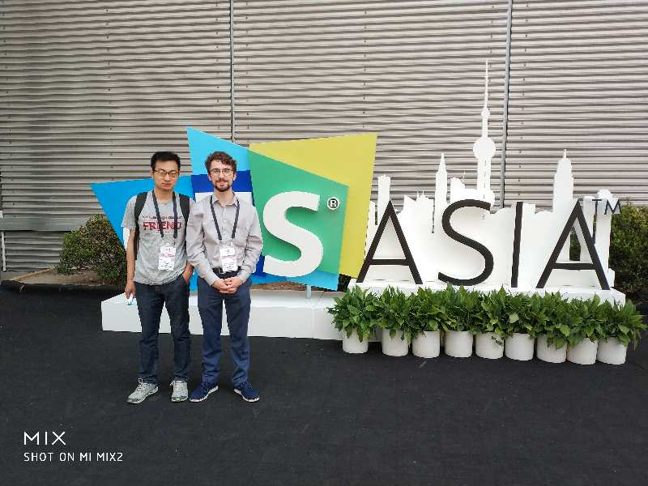
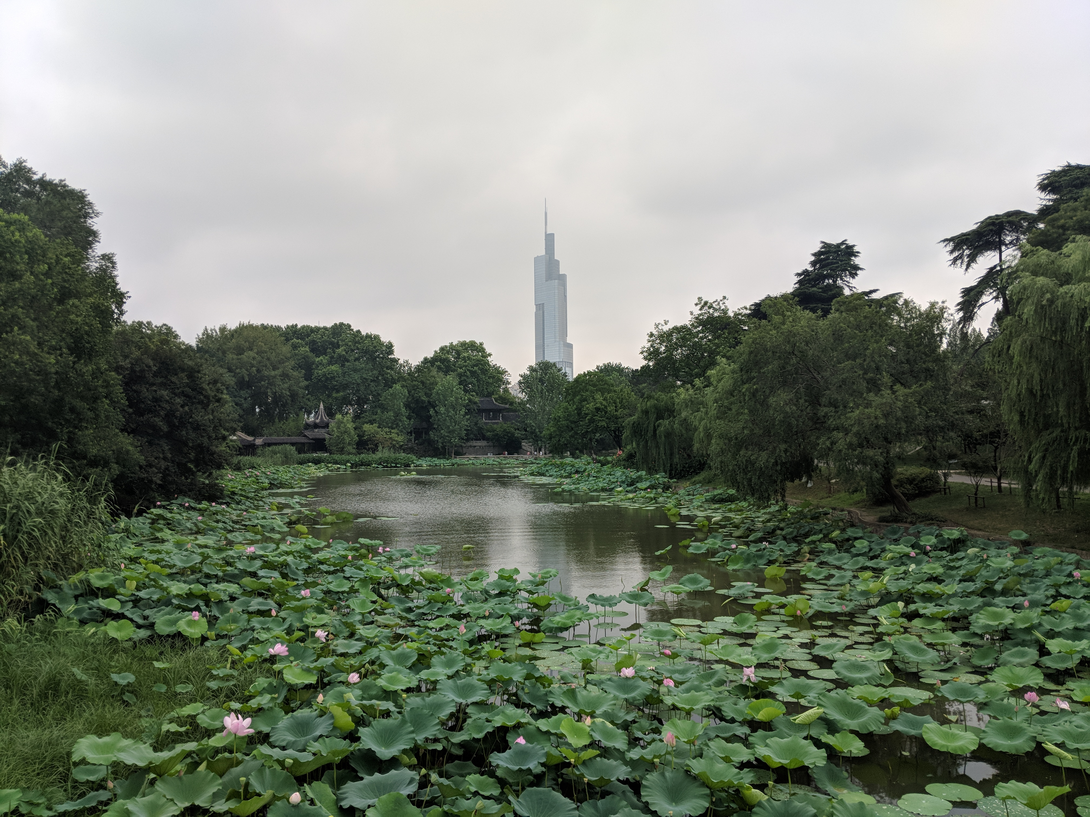
Goodbye China
I have had a really amazing stay in Shanghai. I was able to visit many places on the weekends including Suzhou, Hangzhou, and Nanjing.
Two of my favorite things here have been the food and the infrastructure. I really enjoy high speed rail trips.
I also learned a lot during my internship. Coming in I had no experience with PCL but now feel fairly confident using it. I was also able to refine and improve my skills in ROS. And also learn about Chinese culture.

